Slide 1


IBM SkillsBuild
Data Analytics Internship Programme

Slide 2
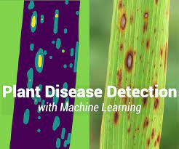
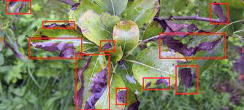
Plant Disease Detection Using Machine Learning
GROUP NO: 09
PRESENTED BY Team Athena

Slide 3







TEAM MEMBERS
Merisa Mascarenhas
Anujeet Kunturkar
Merisa Mascarenhas
Nilesh Mishra
Maheshwaran
Antara Kolhatkar
Mervis Mascarenhas

Slide 4

INTRODUCTION
Plant diseases are a major problem for agriculture, causing billions of dollars in losses each year. Traditional methods of plant disease detection, such as visual inspection, can be time-consuming and inaccurate. Machine learning can be used to automate the process of plant disease detection, providing farmers with a more efficient and accurate way to identify and manage plant diseases.

Slide 5

PROJECT SUMMARY
Monkeypox is an infectious viral disease that can occur in humans and a few other animals. Monkeypox virus, scientifically called zoonotic viruses in the genus Orthopoxvirus, is the cause of the disease. It may spread from infected animals by handling infected meat or via bites or scratches.
Human-to-human transmission can occur through exposure to infected body fluids, contaminated objects, contaminated tiny droplets, and possibly the airborne route. The first confirmed case was traced to an individual with travel links to Nigeria (where the disease is endemic) and was detected on May 6, 2022. Although, the cases were already spreading in the previous months, according to suggestions. From 18 May onwards, cases were reported from an increasing number `of countries and regions, predominantly in Europe but also in North and South America, Asia, Africa, and Australia.
The World Health Organization has declared this an "Evolving Health Threat" rather than a Public Health Emergency of International Concern.
This project will use machine learning to develop a system for detecting plant diseases from images. The system will first collect a dataset of images of healthy and diseased plants. These images will be used to train a machine learning model that can identify the diseases of the plants. Once the model is trained, it will be able to detect diseased plants. Further a crop recommendation system, recommends crops based on soil content and wheatear description.

Slide 6



PURPOSE OF THE PROJECT
The purpose of this project is to develop a system that can help farmers to more effectively detect plant diseases.
The system will be able to identify plant diseases earlier, which will allow farmers to take action to prevent the spread of the disease and protect their crops.
The system will also be more accurate than traditional methods of plant disease detection, which will help farmers to make better decisions about how to manage their crops.
The system also recommends crops which can help farmers decide which crop to cultivate.

Slide 7

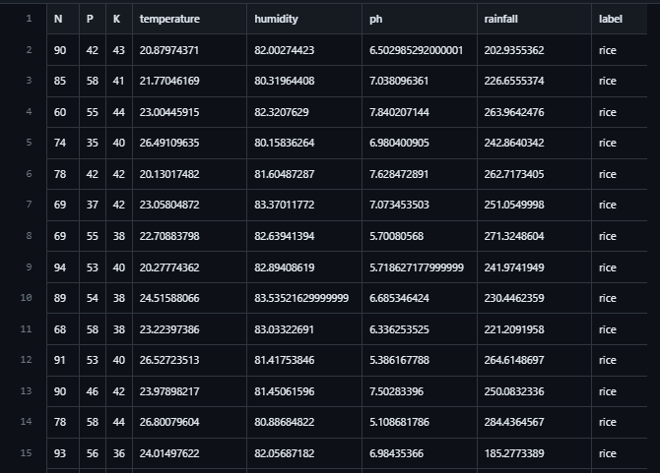
SOURCES OF DATA USED
The dataset used in this project is taken from Kaggle. There are several attributes in the data set on which we are predicting, analyzing, visualizing, and performed detection of Plant Diseases through images.
Dataset for Plant Leaf Disease Detection:
https://www.kaggle.com/datasets/vipoooool/new-plant-diseases-dataset
Dataset for Crop Recommendation:
https://github.com/Gladiator07/Harvestify/blob/master/Data-processed/crop_recommendation.csv

Slide 8
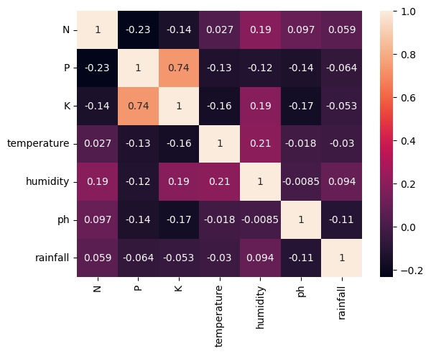
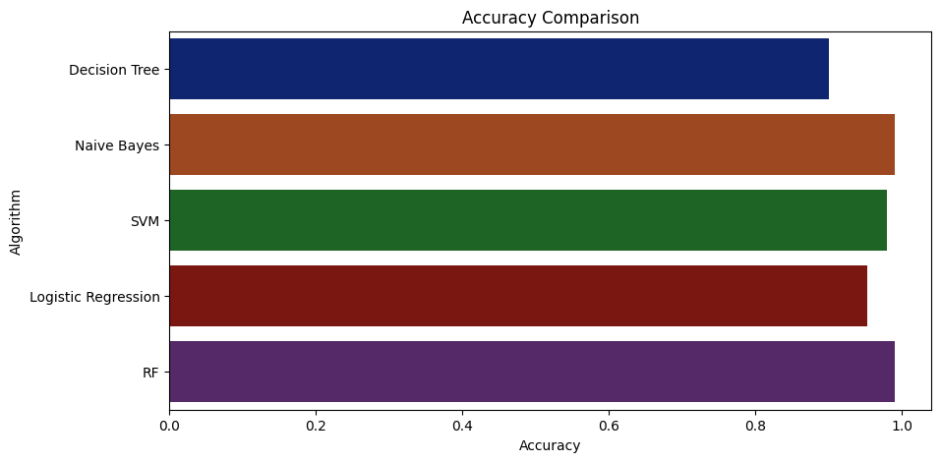
DATA VISUALISATION OF CHARTS AND GRAPHS FOR CROP RECOMMENDATION
Here we are showing some Exploratory Data Analysis (EDA) from data sets which we have used.
Algorithm V/S Accuracy for Crop Recommendation

Slide 9
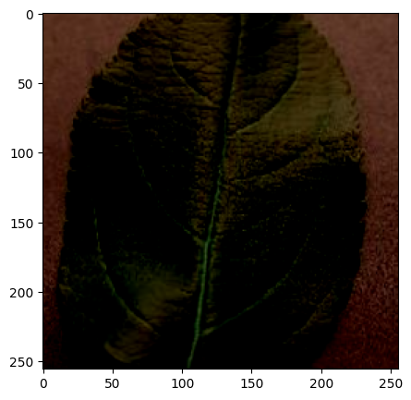
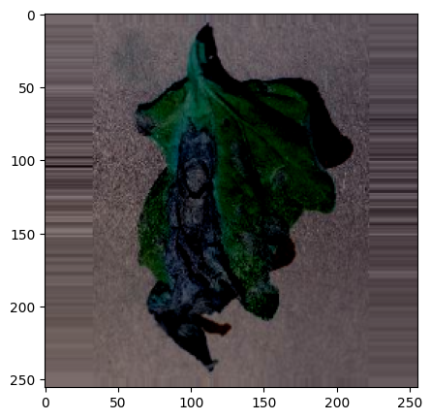
DATA PREPROCESSING
FOR PLANT DISEASE DETECTION

Slide 10

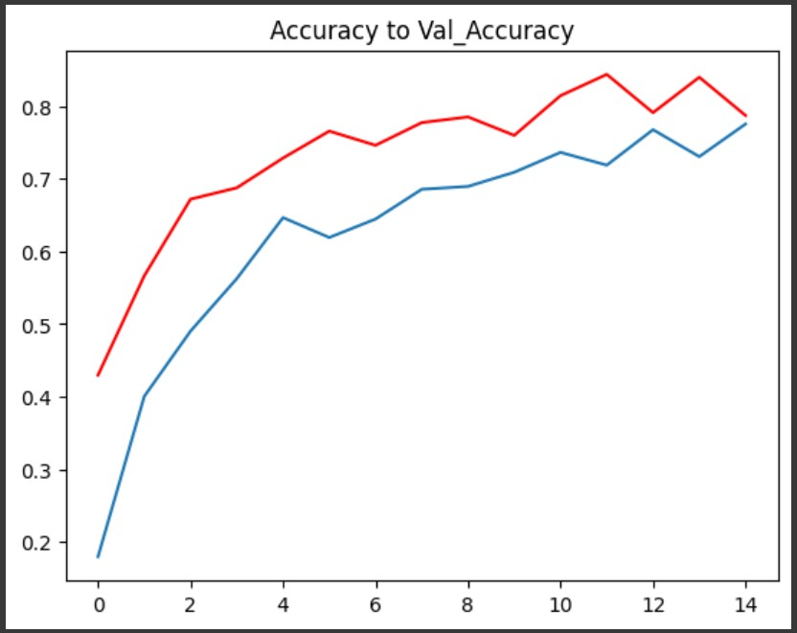
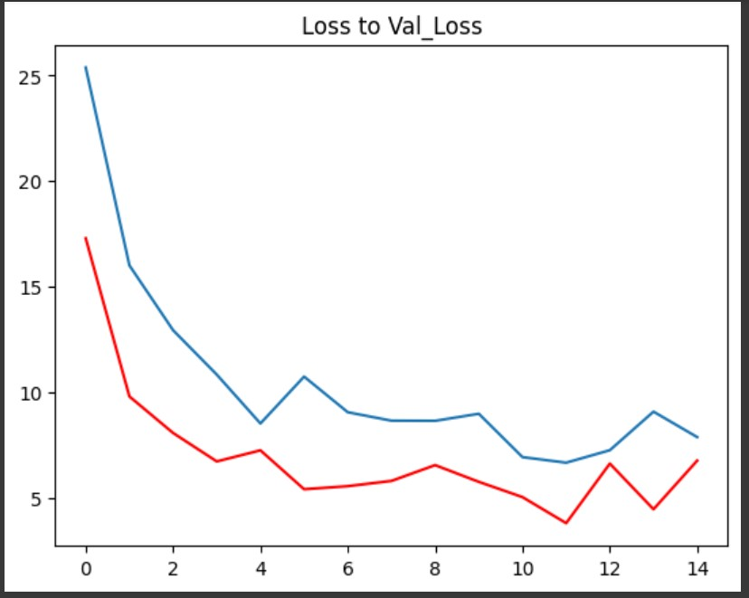
ACCURACY AND LOSSES

Slide 11
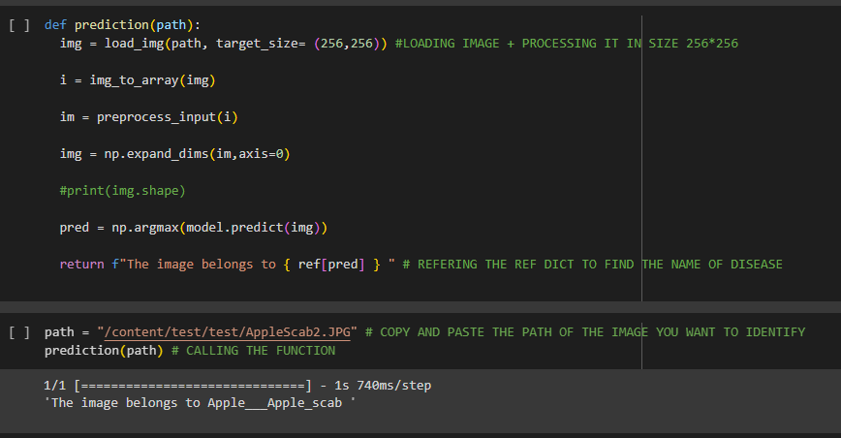
In that prediction, we had 82.08513259887695 %
Accuracy.
Here we have taken one picture from datasets to predict Plant Leaf Disease.

Slide 12
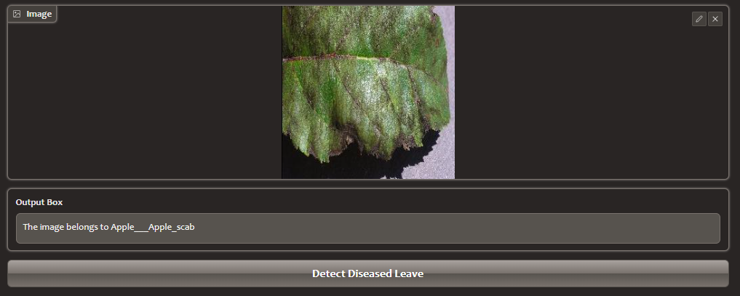
Plant Leaf Detection Output

Slide 13

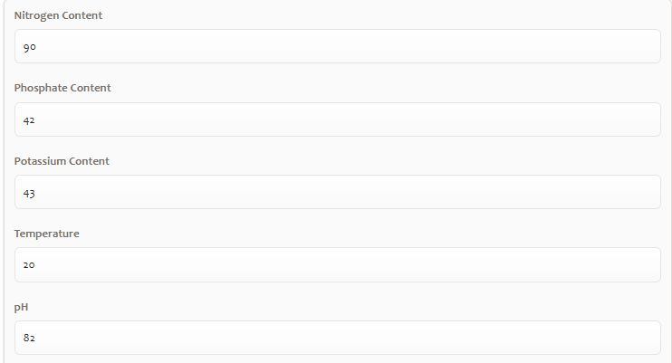
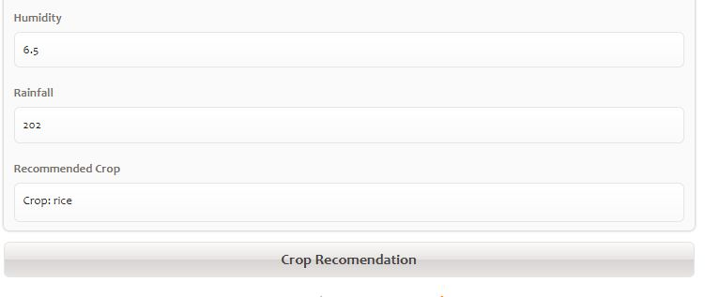
Crop Recommendation Output
Crop Recommendation
INPUT:
Nitrogen
phosphate, potassium, temperature
Ph
Humidity
Rainfall.
OUTPUT: Crop that fits the category.

Slide 14


CONCLUSION
The development of a machine learning system for plant disease detection has the potential to revolutionize the way that farmers manage their crops. The system will be more efficient, accurate, and cost-effective than traditional methods of plant disease detection. This will help farmers to protect their crops from disease and ensure a healthy harvest.

Slide 15



